Slide 1
Using the OpenVINO™ Toolkit for Deploying Accelerated Deep Learning Applications
May 2022
Part1 [2022.1]

Slide 2
Notices and disclaimers
Performance varies by use, configuration, and other factors. Learn more at intel.com/PerformanceIndex .
Performance results are based on testing as of dates shown in configurations and may not reflect all publicly available updates. See backup for configuration details. No product or component can be absolutely secure.
Your costs and results may vary.
Intel® technologies may require enabled hardware, software, or service activation.
Intel® optimizations, for Intel® compilers or other products, may not optimize to the same degree for non-Intel products.
Intel does not control or audit third-party data. You should consult other sources to evaluate accuracy.
Results have been estimated or simulated.
Intel is committed to respecting human rights and avoiding complicity in human rights abuses. See Intel’s Global Human Rights Principles. Intel® products and software are intended only to be used in applications that do not cause or contribute to a violation of an internationally recognized human right.
© Intel Corporation. Intel, the Intel logo, and other Intel marks are trademarks of Intel Corporation or its subsidiaries. Other names and brands may be claimed as the property of others.

Slide 3
System configuration
System board | Intel prototype, TGL U DDR4 SODIMM RVP | ASUSTek COMPUTER INC./Prime z370-a
CPU | 11th Gen Intel® Core™ i5-1145G7 @ 2.6 GHz | 8th Gen Intel ® Core™ i5-8500t @ 3.0 GHz
Sockets/physical cores | 1/4 | 1/6
Hyperthreading/turbo setting | Enabled/On | NA/On
Memory | 2 x 8198 MB 3200 MT/s DDR4 | 2 x 16384 MB 2667 MT/s DDR4
OS | Ubuntu 18.04 LTS | Ubuntu 18.04 LTS
Kernel | 5.8.0-050800-generic | 5.3.0-24-generic
Software | Intel® Distribution of OpenVINO™ toolkit 2021.1.075 | Intel Distribution of OpenVINO toolkit 2021.1.075
BIOS | Intel TGLIFUI1.R00.3243.A04.2006302148 | AMI, version 2401
BIOS release date | June 30, 2020 | July 12, 2019
BIOS setting | Load default settings | Load default settings, set XMP to 2667
Test date | September 9, 2020 | September 9, 2020
Precision and batch size | CPU: int8, GPU: FP16-int8, batch size: 1 | CPU: int8, GPU: FP16-int8, batch size: 1
Number of inference requests | 4 | 6
Number of execution streams | 4 | 6
Power (TDP link) | 28W | 35W
Price (USD) link on 02/25/2022 Prices may vary | USD 312 | USD 192
1) Memory is installed such that all primary memory slots are populated.
2) Testing by Intel as of September 9, 2020.

Slide 4
Compounding effect of hardware and software configuration
See the compounding effect
System board | 1) Purley E63448-400, Intel® Internal Reference System | 2) Intel® Server Board S2600STB | 3) Intel Server Board S2600STB | 4) Intel® Internal Reference System
CPU | Intel® Xeon® Silver 4116 @ 2.1 GHz | Intel® Xeon® Silver 4216 CPU @ 2.10 GHz | Intel® Xeon® Silver 4216R CPU @ 2.20 GHz | Intel® Xeon® Silver 4316 CPU @ 2.30 GHz
Sockets, physical cores/socket | 2, 12 | 2, 16 | 2, 16 | 2, 20
Hyperthreading/turbo setting | Enabled/On | Enabled/On | Enabled/On | Enabled/On
Memory | 12x 16 GB DDR4 2400 MHz | 12x 64 GB DDR4 2400 MHz | 12x 32GB DDR4 2666 MHz | 16 x32GB DDR4 2666 MHz
OS | UB-16.04.3 LTS | UB-18.04 LTS | UB-18.04 LTS | UB-20.04 LTS
Kernel | 4.4.0-210-generic | 4.15.0-96-generic | 5.3.0-24-generic | 5.13.0-rc5-intel-next+
Software | Intel® Distribution of OpenVINO™ toolkit R5 2018 | Intel® Distribution of OpenVINO™ toolkit R3 2019 | Intel® Distribution of OpenVINO™ toolkit 2021.2 | Intel® Distribution of OpenVINO™ toolkit 2021.4.1
BIOS | PLYXCRB1.86B.0616.D08.2109180410 | — | Intel Corporation SE5C620.86B.02.01. 0009.092820190230 | WLYDCRB1.SYS.0020.P93.2103190412
BIOS release date | September 18, 2021 | — | September 28, 2019 | March 19, 2021
BIOS setting | Select optimized default settings, save, and exit | Select optimized default settings, save, and exit | Select optimized default settings, change power policy to "performance," save, and exit | Select optimized default settings, change power policy to "performance," save, and exit
Test date | October 8, 2021 | September 27, 2019 | December 24, 2020 | September 6, 2021
Precision and batch size | FP32/Batch 1 | int8/Batch 1 | int8/Batch 1 | int8/Batch 1
Workload: model/image size | MobileNet-SSD/300x300 | MobileNet-SSD/300x300 | MobileNet-SSD/300x300 | MobileNet-SSD/300x300
Number of inference requests | 24 | 32 | 32 | 10
Number of execution streams | 24 | 32 | 32 | 10
Power (TDP link) | 170W | 200W | 250W | 300W
Price (USD) link on 02/25/2022 Prices may vary | USD 2,024 | USD 1,926 | USD 2,004 | USD 2,166

Slide 5
Agenda
Introduction to OpenVINO™ Toolkit
System Requirements
Installation Methods
[Demo/Lab1] - Hello World
Open Model Zoo
[Demo/Lab2] - Model Tools
Model Optimizer
OpenVINO™ Runtime
[Demo/Lab3] - OpenVINO API
[Demo/Lab4] - Convert TensorFlow/PyTorch/PaddlePaddle to IR and run the inference
[Demo/Lab5] - Speech to Text Recognition Sample using Dynamic Shape
Multiple Models in One Application
[Demo/Lab6] – Optical Character Recognition Sample with Two Models in Use

Slide 6
Introduction to OpenVINO™ Toolkit

Slide 7
Why deep learning
There is tremendous opportunity in the global growth in chipset revenue driven by AI inference
$51.9B
Driven by
AI inference
by 2025
Source: Intel AI Market Model/Omdia Q2’20 AI Chipsets Report.
All figures are in US Dollars.
Notes:
Speaker Notes:
The need for artificial intelligence on edge devices has been realized and the race to design edge-optimized chipsets have begun
According to research from Omdia, the global edge AI chipset revenue will reach $51.9 bn by 2025, driven by the increasing need for AI inference at the edge
Particularly, AI processing on the edge circumvents privacy concerns while avoiding the bandwidth, latency and cost concerns of cloud computing

Slide 8

Challenges in deep learning
Development and deployment challenges in deep learning
Unique inference needs
Integration challenges
No one size fits all
Gap in performance and accuracy between trained and deployed models
No way to streamline end-to-end development workflow
Diverse requirements for myriad use cases require unique approaches
Low-performing, lower- accuracy models deployed
Slow time to solution and time to market
Inability to meet use-case-specific requirements
Notes:
Even with the amount of breakthroughs and new opportunities deep learning enables, there is still very little deep learning deployments today
Unique Inference Needs
Deploying deep learning networks from training environments, typically in data centers or server farms, to real-world production use cases, has been very challenging.
There is a significant gap in performance and accuracy seen in trained models compared to what gets deployed in the field
There are unique sets of technical challenges that come into play when it comes to deployment
Integration Challenges
Typically the training of the deep learning networks is performed in data centers or server farms while the inference might take place on embedded platforms, optimized for performance and power consumption
There is a disconnect in the end-to-end development workflow
From a software perspective, there are various programming languages, third-party dependencies, memory consumption and supported operating systems
From a hardware perspective, there are different data types, limited power envelope and form factor constraints
There is a need for a dedicated API, or a communication link, between the software and hardware
No One Size Fits All
There are diverse requirements for myriad use cases that require unique approaches
For every problem, there could be a unique combination of networks, models and target device

Slide 9







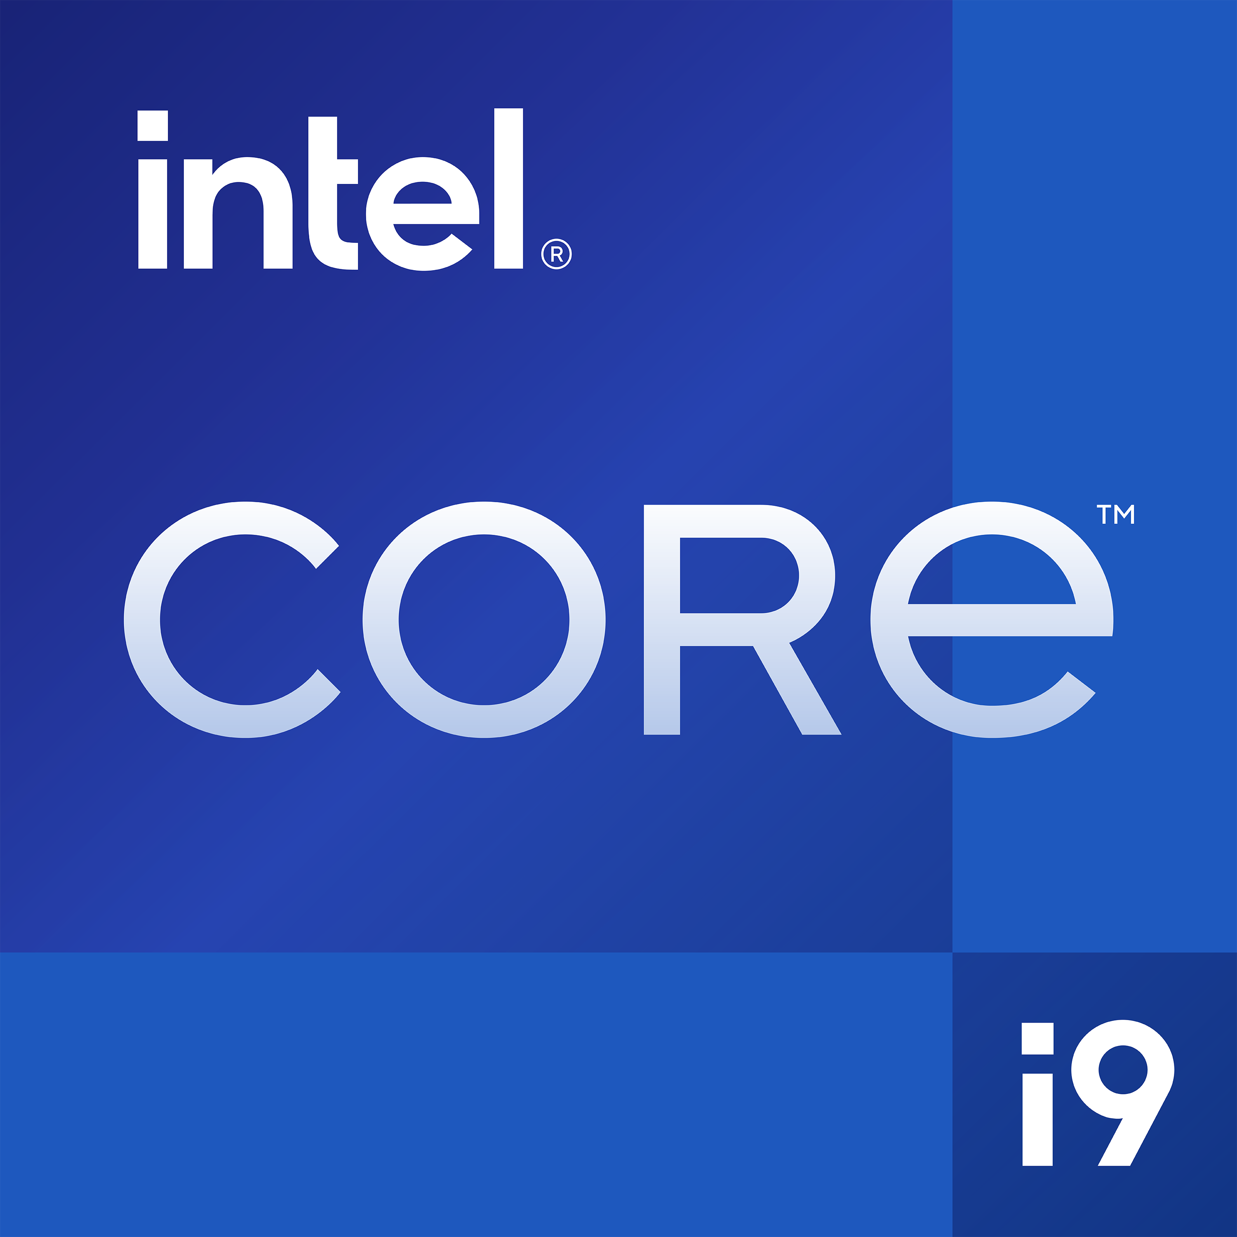


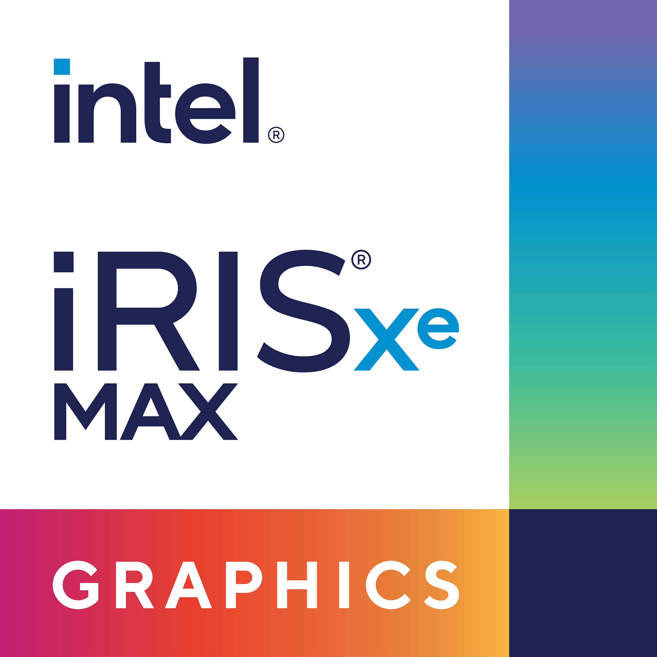


Why Intel® Distribution of OpenVINO™ Toolkit
Fast, accurate real-world results with high-performance, deep learning inference
Convert and optimize models, deploy across a mix Intel hardware and environments, on-premise and on-device, in the browser or in the cloud
1
BUILD
PaddlePaddle
2
optimized performance
OPTIMIZE
CPU
GPU
iGPU
VPU
3
DEPLOY
Windows
Linux
macOS
Notes:
OpenVINO is short for Open Vision Inference and Neural Network Optimization, but the toolkit can accelerate AI workloads including computer vision, audio, speech, language, and recommendation systems, which enables high performing applications and algorithms to be deployed in the real world.
It is a tool suite for high-performance, deep learning targeted at faster, more accurate real-world results deployed into production across Intel architecture from edge to cloud.
Besides, the path to inferencing is simplified with a streamlined development workflow. With a write once, deploy anywhere approach, developers can write an application or algorithm once and execute heterogeneously across Intel architectures, including CPU, integrated GPU, Intel Movidius VPU, and GNA (Gaussian & Neural Accelerator) and deploy it across Intel® architecture, including CPU, iGPU, Movidius VPU, and GNA
Note full ARC (DG2) support will be added in 2022.2

Slide 10

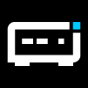



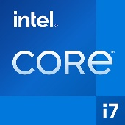


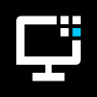
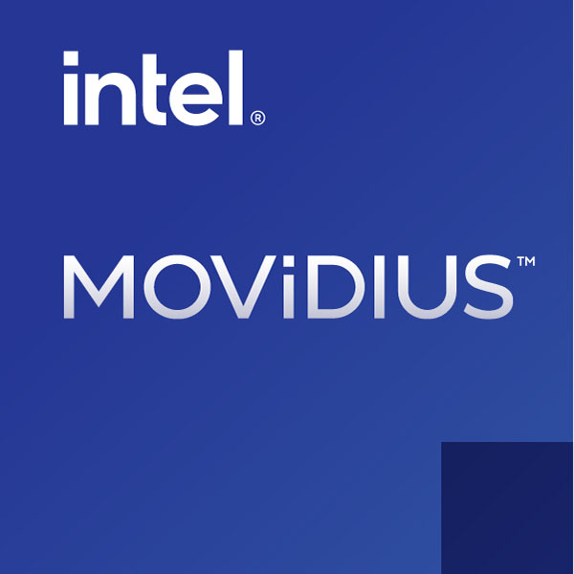



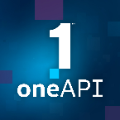
OpenVINO™ Toolkit Developer Journey
1
2
3
BUILD
OPTIMIZE
DEPLOY
Local or Remote Systems
Read, Load, Infer
Model Optimizer
Converts and optimizes trained model using a supported framework
Intermediate Representation (.xml, .bin)
OpenVINO Runtime
Common API that abstracts low-level programming for each hardware
IR Data
Trained model
Post-Training Optimization Tool
Reduces model size into low-precision without retraining
Deep Learning Streamer
Deployment Manager
Neural Network Compression Framework
Compression algorithms for quantization-aware training with PyTorch and TensorFlow frameworks
OpenCV
OpenCL™ Drivers & Runtime [Linux]
Code Samples and Demos
(e.g. Benchmark app, Accuracy Checker, Model Downloader)
Serving Models
Model Server
gRPC/ REST Server with C++ backend
Open Model Zoo
280+ open sourced and optimized pretrained models available
Deep Learning Workbench
Visually analyze and fine-tune
Powered by oneAPI
The productive, smart path to freedom for accelerated computing from the economic and technical burdens of proprietary alternatives.
Notes:
To develop an application with OpenVINO toolkit, there are basically three steps.
First step, build.
Developers need to either create and train their DEEP LEARNING models with popular frameworks or download pre-trained models from Open Model Zoo. Currently, OpenVINO supports Caffe*, Tensorflow*, MXnet*, ONNX*, PaddlePaddle and Kaldi*, for those non-directly supported frameworks such as PyTorch, users can convert them into ONNX format.
Second step, optimize.
Developers will use a key component of OpenVINO named Model Optimizer to convert the pre-trained model to the Intermedia Representation format.
The Intermedia Representation, also known as IR files, will be loaded onto OpenVINO Runtime which contains common APIs for loading the IR files to the plugins of the selected hardware for inferencing. Each plugin is a shared library that contains complete implementation for inference on this device, which has its internal optimization algorithms, and this is hardware related optimization, happens at runtime. Besides, ONNX and PaddlePaddle models can be directly loaded to OpenVINO Runtime as well.
Developers who would like to perform further model optimization without re-training, could use the Post-Training Optimization Tool(POT), and conduct in-training optimization with the tool named Neural Network Compression Framework (NNCF).
Another tool called DEEP LEARNING Workbench is the graphical interface designed to make the production of pretrained deep learning Computer Vision and Natural Language Processing models significantly easier. Minimize the inference-to-deployment workflow timing for neural models right in your browser: import a model, analyze its performance and accuracy, visualize the outputs, optimize and make the final model deployment-ready in a matter of minutes.
Intel® DL Streamer is a streaming media analytics framework, based on GStreamer* multimedia framework, for creating complex media analytics pipelines.
OpenCV is also pre-installed within the OpenVINO toolkit, which helps to handle the image processing tasks. And the OpenCL driver and runtime are needed for running inference onto non-CPU architectures.
A list of Inference Engine code samples is also included for developers’ reference.
Third, Deploy.
Normally the development environment is different from the deployment environment. The Deployment Manager will help developers to create deployment package by assembling the model, IR files, application, and associated dependencies into a runtime package for their target device.

Slide 11
What’s New with OpenVINO™ Toolkit 2022.1 Release
Updated, Cleaner API
Broader Model Support
Portability and Performance
The new AUTO plugin discovers available devices and runs inference workloads dynamically across CPU, GPU, and XPUs
The 2022.1 release aligns with TensorFlow conventions, streamlines optimization, and improves conversion. performance.
Tackle more applications including natural language processing (NLP), PaddlePaddle models, and anomaly detection.
Performance has been significantly improved for model conversion on Open Neural Network Exchange (ONNX*) models
Model Optimizer parameters have been reduced to minimize complexity
OpenVINO 2022.1 adds Dynamic Input Shapes, more NLP models for training speech denoising and updates on speech recognition and speech synthesis
Support for select PaddlePaddle* models
Pretrained models for Anomaly Detection including anomaly segmentation for industrial inspection
The AUTO feature uses performance hints to define latency, throughput, and batching requirements—device and runtime logic configure themselves
AUTO maximizes hybrid architectures for high performance inferencing on platforms with CPUs and integrated GPUs like 12th Gen Intel® Core™ processors (aka Alder Lake)
Note: In OpenVINO™ 2022.1, Dynamic Input Shapes run on CPUs only.
Notes:
Part of the new 30-3-30 and will be available this week with a fast follow of updates we’re continuing to make this month.

Slide 12
System Requirements

Slide 13
Development Platforms
Processors
6th to 12th generation Intel® Core™ processors
1st to 3rd generation of Intel® Xeon® Scalable processors
Compatible Operating Systems
Ubuntu* 18.04 LTS (64 bit)
Ubuntu 20.04 LTS (64 bit)
Windows® 10 (64 bit)
Windows* 11 (recommended for 12th generation Intel Core processors)
Red Hat* Enterprise Linux* 8 (64 bit)
macOS* 10.15 (64 bit)
System Requirements:
https://www.intel.com/content/www/us/en/developer/tools/openvino-toolkit/system-requirements.html

Slide 14

Target System Platforms
Processors / Accelerator |  | Compatible Operating Systems
 |  | Ubuntu 18.04 LTS (64 bit) | Ubuntu 20.04 LTS (64 bit) | Windows 10 (64 bit) | Windows 11 | Red Hat Enterprise Linux 8 (64 bit) | macOS 10.15 (64 bit) | Yocto Project* Poky Zeus v3.0.x (64 bit) | Raspbian Buster or Stretch (32-bit)
CPU | 6th to 12th generation Intel Core processors 1st to 3rd generation of Intel® Xeon® Scalable processors Intel Atom® processor with Intel® Streaming SIMD Extensions 4.2 (Intel® SSE4.2)
GPU | 6th to 12th generation Intel Core processor with Intel® Iris® Plus and Intel® Iris® Pro graphics and Intel HD Graphics 11th generation Intel Core processor with Xe architecture Intel Xeon processor with Intel® Iris® Plus and Intel Iris Pro graphics and Intel HD Graphics (excluding the e5 family which does not include graphics) Intel® Iris® Xe MAX Graphics
VPU | Intel Vision Accelerator Design with Intel® Movidius™ Vision Processing Unit (VPU) Intel® Neural Compute Stick 2
GNA | Intel® GNA

Slide 15
Choose Between Release Types Standard Releases vs Long-Term Support Releases
Standard Release (3-4 releases a year): Users looking to take advantage of new features, tools and support in order to keep current with the advancements in deep learning technologies
Long-Term Support Release: Users looking for a stable and reliable version that is maintained for a longer period, and are looking for little to no new feature changes
Notes:
There are two types of release for the Intel Distribution of OpenVINO Toolkit, Standard Releases and Long-Term Support Releases.
Standard Release will have 3-4 releases a year, for users who are looking to take advantage of the new features, tools and support in order to keep current with the advancements in deep learning technologies, while some of the old features might be removed from the standard release.
Long-Term Support Release is maintained once a year and supported for two years, for users who are looking for a stable and reliable version that has little to no new feature changes.

Slide 16
Installation Methods

Slide 17
OpenVINO™ Install Steps For Python Developers using CPU and GPU only
OpenVINO™ Developer Package
All you need is one line command:
pip install openvino-dev
Tools included in this Developer Package:
OpenVINO™ Runtime
Model Optimizer
Post-Training Optimization Tool
Benchmark Tool
Accuracy Checker and Annotation Converter
Model Downloader and other Open Model Zoo tools
OpenVINO Developer Package on PyPi.org:
https://pypi.org/project/openvino-dev/
Notes:
Since the 2022.1 release, the OpenVINO installation package has been separated into two parts: OpenVINO Runtime and OpenVINO Development Tools. See the following instructions to choose your installation process.
For Python developers, you can install OpenVINO from PyPI, which contains both OpenVINO Runtime and Development Tools, while requiring fewer steps.
For C++ developers, you may choose one of the following installation options for OpenVINO Runtime on your specific operating system:
Linux: You can install OpenVINO Runtime using an Installer, APT, YUM, Anaconda Cloud, or Docker.
Windows: You can install OpenVINO Runtime using an Installer, Anaconda Cloud, or Docker.
macOS: You can install OpenVINO Runtime using an Installer or Anaconda Cloud.
Raspbian OS.

Slide 18
OpenVINO™ Install Steps For both C++ and Python Developers would use VPU, GNA in addition to CPU, GPU
OpenVINO™ Runtime Package
Install OpenVINO runtime
Configure Non-CPU Devices
Enable GPU, VPU, and GNA (Myriad-X) as needed (Optional)
OpenCV
Install OpenCV as needed (Optional)
Sample / Demo programs require OpenCV to build and run
OpenVINO™ Developer Package
Package Installer
yum / apt
pip / conda
Model Optimizer
Post-Training Optimization Tool
Benchmark Tool
Accuracy Checker and Annotation Converter
Model Downloader and other Open Model Zoo tools
OpenVINO Get Started Guide:
https://docs.openvino.ai/latest/get_started.html
Notes:
Since the 2022.1 release, the OpenVINO installation package has been separated into two parts: OpenVINO Runtime and OpenVINO Development Tools. See the following instructions to choose your installation process.
For Python developers, you can install OpenVINO from PyPI, which contains both OpenVINO Runtime and Development Tools, while requiring fewer steps.
For C++ developers, you may choose one of the following installation options for OpenVINO Runtime on your specific operating system:
Linux: You can install OpenVINO Runtime using an Installer, APT, YUM, Anaconda Cloud, or Docker.
Windows: You can install OpenVINO Runtime using an Installer, Anaconda Cloud, or Docker.
macOS: You can install OpenVINO Runtime using an Installer or Anaconda Cloud.
Raspbian OS.

Slide 19
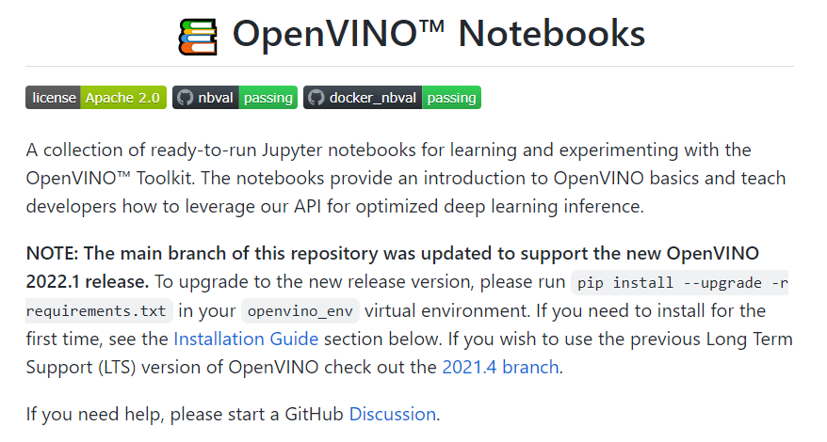
Get Started with OpenVINO™ Notebooks https://github.com/openvinotoolkit/openvino_notebooks

Slide 20
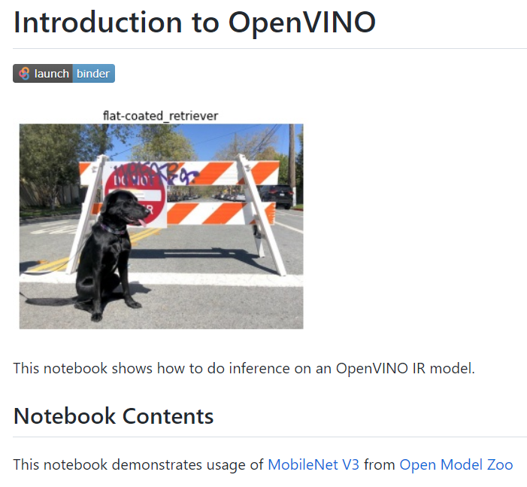
OpenVINO Notebooks - 001-hello-world
https://github.com/openvinotoolkit/openvino_notebooks/tree/main/notebooks/001-hello-world

Slide 21
Open Model Zoo
Notes:
For users do not have their own models or want to try Intel/public models

Slide 22
How to Obtain OpenVINO™ IR Models
omz_converter
(wraps Model Optimizer)
Public
Pre-trained
Models
Open Model Zoo
280+ open sourced and optimized pretrained models available
Model
Downloader
Model
Converter
omz_downloader
Intel Pre-trained Models
Model
Optimizer
Intermediate Representation
(.xml + .bin)
mo
User Trained Models

Slide 23
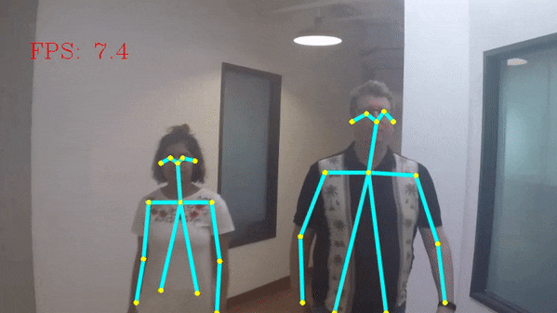
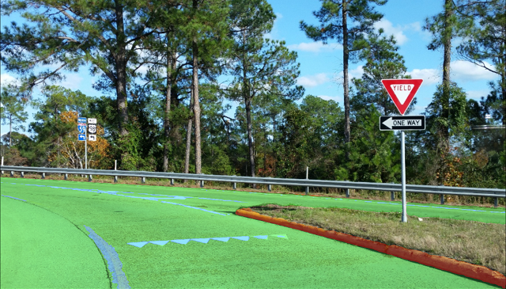
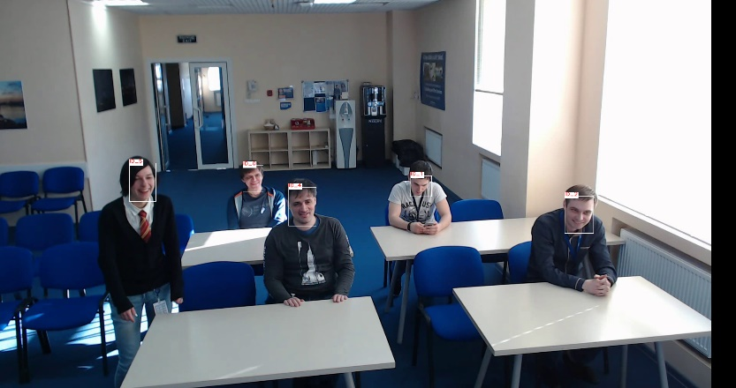
What is in the Open Model Zoo Repository?
Intel Pre-Trained Models (pre-converted)
Public Pre-Trained Models
Model Downloader and other automation tools
Demos that demonstrate model usage with OpenVINO™ Toolkit

Slide 24
Types of Models
Object Detection
Object Recognition
Reidentification
Semantic Segmentation
Instance Segmentation
Human Pose Estimation
Image Processing
Text Detection
Text Recognition
Text Spotting
Action Recognition
Image Retrieval
Question Answering
Machine Translation
Text To Speech
Speech Noise Suppression
Time Series Forecasting
Action Sequence Modeling
Face Recognition
Monocular Depth Estimation
Image Inpainting
Style Transfer
Colorization
Sound Classification
Image Translation
Optical Character Recognition
Deblurring
JPEG Artifacts Removal
Salient Object Detection
Text Prediction
Named Entity Recognition
Vehicle Reidentification
Background Matting
Speech Recognition
Compressed
Open Model Zoo docs:
https://docs.openvino.ai/latest/model_zoo.html
Notes:
User can find out demo usage information on the individual model document page
Also can find out which models can be used on a particular model on model document page

Slide 25
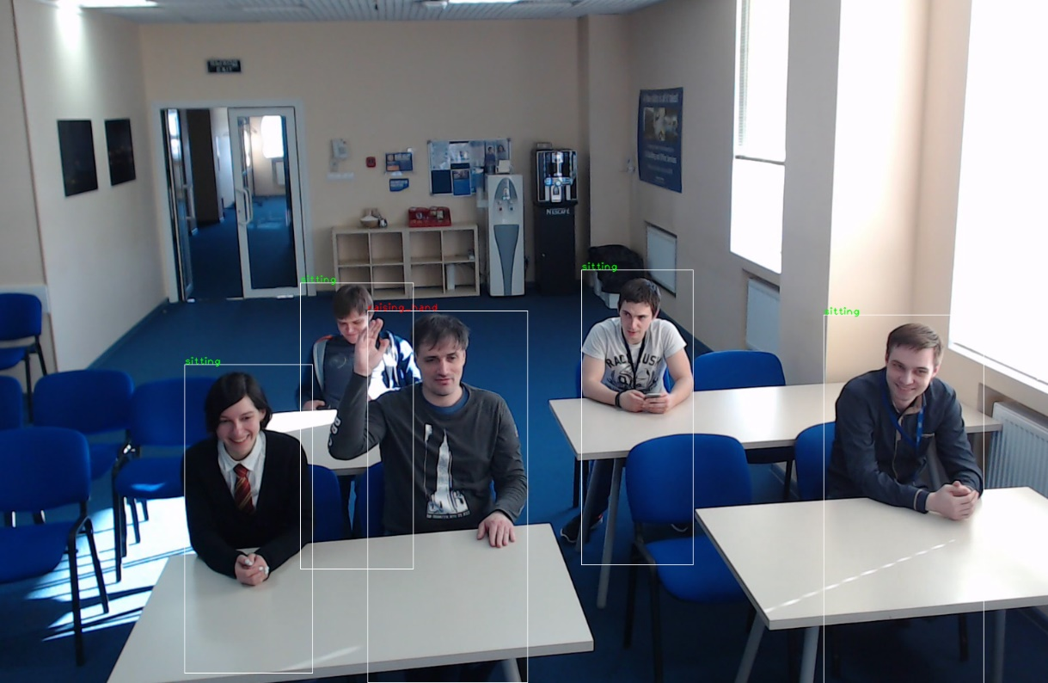
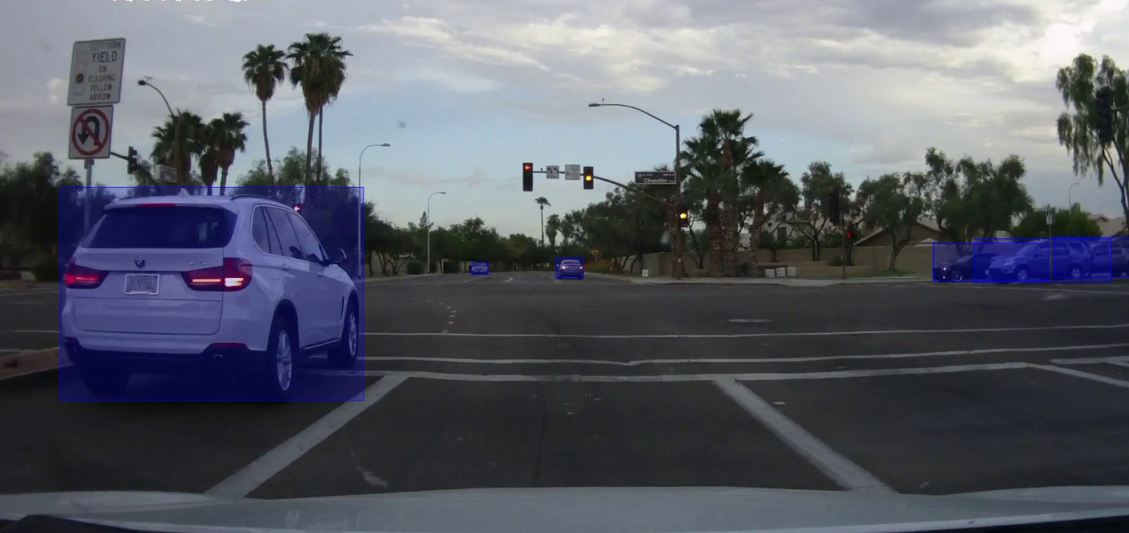
Object Detection and Recognition
Several detection models can be used to detect a set of the most popular objects - for example, faces, people, vehicles.
Object recognition models are used for classification, regression, and character recognition. Use these networks after a respective detector (for example, Age/Gender recognition after Face Detection).

Slide 26

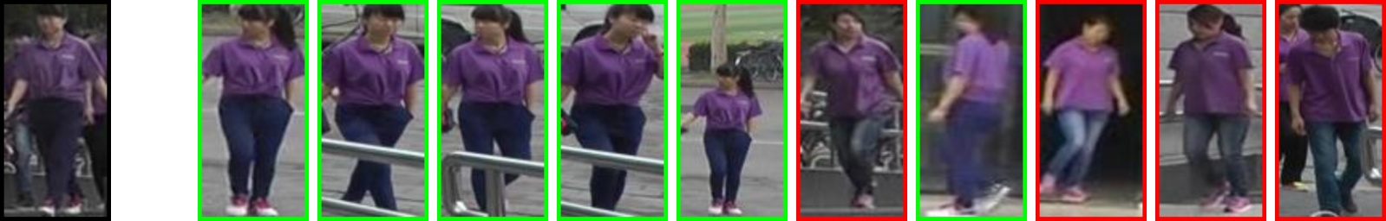
Reidentification Models
Precise tracking of objects in a video is a common application of Computer Vision (for example, for people counting). It is often complicated by a set of events that can be described as a "relatively long absence of an object". For example, it can be caused by occlusion or out-of-frame movement. In such cases, it is better to recognize the object as "seen before" regardless of its current position in an image or the amount of time passed since last known position.

Slide 27
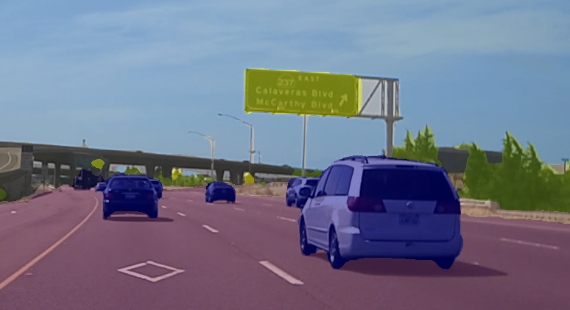
Semantic Segmentation Models
Semantic segmentation is an extension of object detection problem. Instead of returning bounding boxes, semantic segmentation models return a "painted" version of the input image, where the "color" of each pixel represents a certain class.
These networks are much bigger than respective object detection networks, but they provide a better (pixel-level) localization of objects, and they can detect areas with complex shape (for example, free space on the road).

Slide 28

Instance Segmentation Models
Instance segmentation is an extension of object detection and semantic segmentation problems.
Instead of predicting a bounding box around each object instance segmentation model outputs pixel-wise masks for all instances.

Slide 29
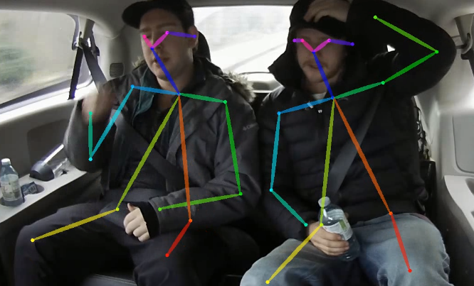
Human Pose Estimation Models
Human pose estimation task is to predict a pose: body skeleton, which consists of key points and connections between them, for every person in an input image or video. Key points are body joints, i.e. ears, eyes, nose, shoulders, knees, etc. There are two major groups of such methods: top-down and bottom-up.
The first detects persons in a given frame, crops or rescales detections, then runs pose estimation network for every detection. These methods are very accurate. The second finds all key points in a given frame, then groups them by person instances, thus faster than previous, because network runs once.

Slide 30
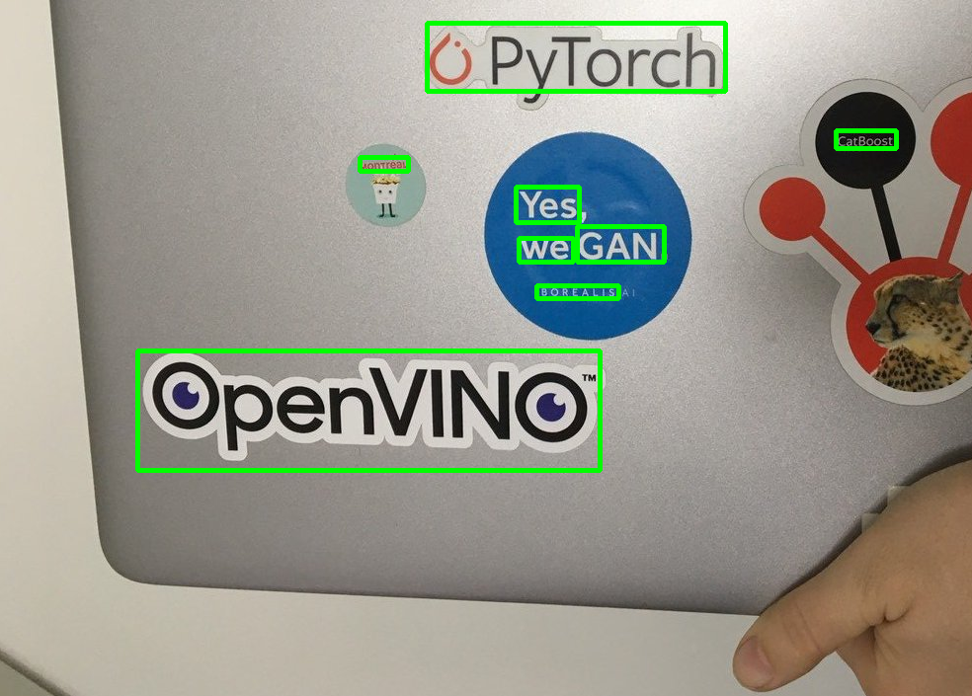
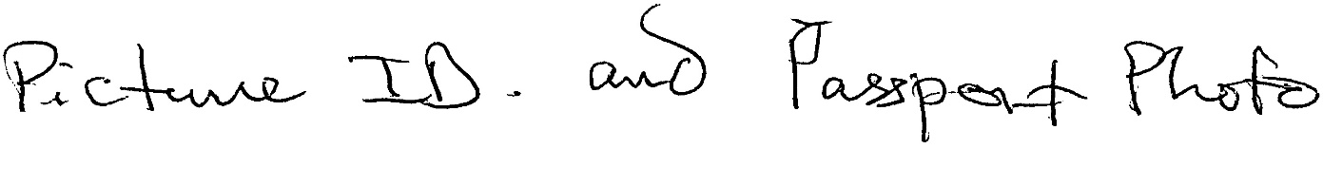

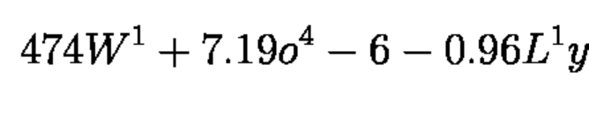

Text Detection and Recognition
Examples of text that can be detected and recognized with different models in the Open Model Zoo

Slide 31
Natural Language Processing Models
For example, you can use a fine-tuned HuggingFace BERT PyTorch model trained on the Microsoft Research Paraphrase Corpus (MRPC) to build a model that compares the meaning of sentences.
The example is in the OpenVINO™ Notebooks on Github*: https://github.com/openvinotoolkit/openvino_notebooks/tree/main/notebooks/105-language-quantize-bert
Are the meanings of these two sentences similar?
The company said it would check all of its million-plus domestic workers to ensure they were legally employed.
It has also said it would review all of its domestic employees more than 1 million to ensure they have legal status.
The same meaning: yes

Slide 32
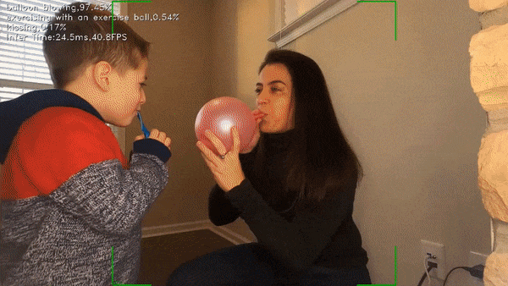
Live Action Recognition with OpenVINO
Human action recognition finds actions over time in a video. The list of actions in this notebook is extensive (400 in total) and covers Person Actions, (e.g., drawing, drinking, laughing), Person-Person Actions (e.g., hugging, shaking hands), and Person-Object Actions (opening present, mowing the lawn, playing "instrument"). You could find several parent-child groupings on the label's list, such as braiding hair and brushing hair, salsa dancing, robot dancing, or playing violin and playing guitar. For more information about the labels and dataset, see "The Kinetics Human Action Video Dataset" research paper.

Slide 33


Image Processing Models
Single Image Super Resolution
An Attention-Based Approach for Single Image Super Resolution but with reduced number of channels and changes in network architecture. It enhances the resolution of the input image by a factor of 4.

Slide 34
Model Downloader Usage
The model downloader allows the developer to easily fetch both publicly available models and Intel provided models. It conveniently free developers from constant searching for the online locations of models.
omz_downloader –all # Download all the models. This takes a while.
This will download all models. The --all option can be replaced with other filter options to download only a subset of models. See the “Shared options” section.
Download a specific model example
omz_downloader --name {model} --output_dir {base_model_dir} --cache_dir {omz_cache_dir} --precision {precision

Slide 35
Model Converter Usage
omz_converter –all
This will convert all models into the OpenVINO™ IR format. Models that were originally in that format are ignored. Models in PyTorch format will be converted in ONNX format first.
The --all option can be replaced with other filter options to convert only a subset of models. See the “Shared options” section.
omz_converter --name {model} --precisions {precision} --download_dir {base_model_dir} --output_dir {base_model_dir}
This command will convert a specific model in the download_dir to a specific format in the output_dir

Slide 36
Model Quantizer Usage
Quantization is using lower-bit representations than higher bits for a given real-valued number. For example, you can represent a continuous real number such as a 32-bit (or, 4 bytes) floating-point number with a discrete number such as an 8-bit (or, 1 byte) integer number.
In this way, users will get a much smaller sized model, with the benefit of improved inference speed .
Before you run the model quantizer, you must prepare a directory with the datasets required for the quantization process. This directory will be referred to as <DATASET_DIR> below.
omz_quantizer --name {model} --dataset_dir <DATASET_DIR>

Slide 37
Model Information Dumper Usage
The basic usage is to run the script like this:
omz_info_dumper –all
The dump is in JSON format by default.
The information includes:
Name
Description
Framework
License
Accuracy
Precisions
Model configurations

Slide 38
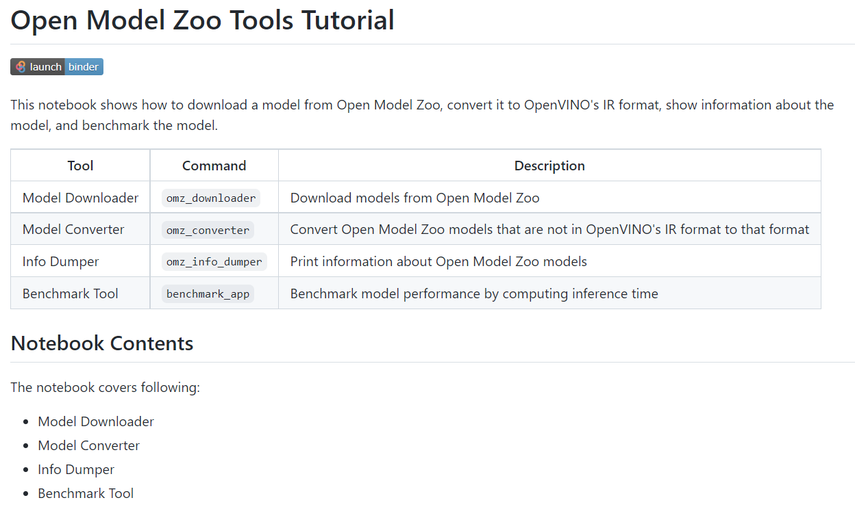
OpenVINO Notebooks - 104-model-tools
https://github.com/openvinotoolkit/openvino_notebooks/tree/main/notebooks/104-model-tools

Slide 39
Model Optimizer
Notes:
As we mentioned in the overview session, MO is not only doing the model conversion but also optimizes the model, then the question is, what kind of optimization does MO do to the model? And how much can you control it? To answer these questions, let’s take a closer look at MO.

Slide 40

Convert model with Model Optimizer
A Python based tool to read trained models and convert them to Intermediate Representation
Optimizes for performance or space with conservative topology transformations
Hardware-agnostic optimizations
The simplest way to convert a model is:
mo --input_model <INPUT_MODEL>
To get the full list of conversion parameters available in Model Optimizer, run the following command:
mo --help
Get Your Model
Intermediate Representation (IR)
.xml and .bin
Run Model Optimizer

Slide 41
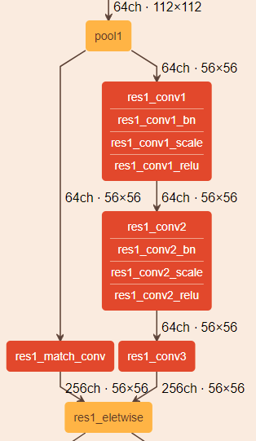
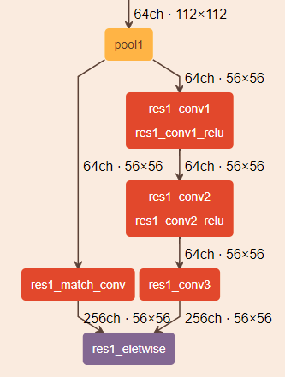
Model Optimizer: Generic Optimization
Operations Pruning
Drop unused operations that only matter for training
Linear Operations Fusing
Many convolution neural networks include “BatchNormalization” and “ScaleShift” operations that can be fused into previous Convolution or FullyConnected operations.
BatchNorm and ScaleShift decomposition: BN layers decomposes to Mul->Add->Mul->Add sequence; ScaleShift layers decomposes to Mul->Add sequence.
Linear operations merge: Merges sequences of Mul and Add operations to the single Mul->Add instance.
Linear operations fusion: Fuses Mul and Add operations to Convolution or FullyConnected layers.
Caffe* Resnet269 (IR)
Caffe* Resnet269 (Original)
Notes:
The topology level optimization that Model Optimizer does to the pre-trained model is hardware-agnostic optimization.
In a pre-trained model, it may contain layers that are important for training, such as the Dropout layer, but useless during inference and might increase the inference time. In many cases, these operations will be automatically removed by Model Optimizer.
If a group of operations can be represented as a single mathematical operation, the Model Optimizer recognizes such patterns and replaces this group of operation nodes with the only one operation. The result is an Intermediate Representation that has fewer operation nodes than the original model which decreases the inference time.
Here’s an example of running Model Optimizer in the command line, assuming no other arguments needed in this example, developers at least need the “--input_model” argument to add the path to the pre-trained model.

Slide 42
Setting Input Shapes with: “--input_shape”
Model Optimizer supports conversion of models with dynamic input shapes that contain undefined dimensions. However, if the shape of data is not going to change from one inference to another, it is recommended to set up fully defined shape for the inputs. It can be beneficial from a performance perspective and memory consumption.
Example1: Run the Model Optimizer for the TensorFlow* MobileNet model with the single input and specify input shape [2,300,300,3].
mo --input_model MobileNet.pb --input_shape [2,300,300,3]
Example2: Launch the Model Optimizer for the ONNX* OCR model with a pair of inputs data and seq_len and specify shapes [3,150,200,1] and [3] for them.
mo --input_model ocr.onnx --input data,seq_len --input_shape [3,150,200,1],[3]
Learn more about Input Shape:
https://docs.openvino.ai/latest/openvino_docs_MO_DG_prepare_model_convert_model_Converting_Model.html

Slide 43
Cutting Off Parts of a Model with: “--input” and ”--output”
Several reasons some parts of a model must be removed while the Model Optimizer is converting models to the Intermediate Representation:
Model has pre- or post-processing parts that cannot be translated
Model has a training part that is convenient to be kept in the model, but not used during inference
Model contains lots of unsupported operations that cannot be easily implemented as custom layers
Problem with model conversion in the Model Optimizer
Single custom layer or a combination of custom layers is isolated for debugging purposes
Example: Cutting at the End
mo --input_model inception_v1.pb --output=InceptionV1/InceptionV1/Conv2d_1a_7x7/Relu
Example: Cutting from the Beginning
mo --input_model inception_v1.pb --input 0:InceptionV1/InceptionV1/Conv2d_1a_7x7/Relu
Learn more about Cutting Off Parts of Model:
https://docs.openvino.ai/latest/openvino_docs_MO_DG_prepare_model_convert_model_Cutting_Model.html

Slide 44
Embedding Preprocessing Computation with: “--mean_values”, “--scale_values”, “--reverse_input_channels”, and “—layout”
Input data for inference can be different from the training dataset and requires additional preprocessing before inference.
Based on these parameters, Model Optimizer generates IR with additionally inserted sub-graph that performs the defined preprocessing so it will be offloaded to the inference device.
As a result, you can end up with faster end-to-end execution time
Example: run the Model Optimizer for the PaddlePaddle* UNet model and apply mean-scale normalization to the input data.
mo --input_model unet.pdmodel --mean_values [123,117,104] --scale 255
Example: launch the Model Optimizer for the TensorFlow* AlexNet model and embed reverse_input_channel preprocessing block into IR.
mo --input_model alexnet.pb --reverse_input_channels
Example: for the nasnet_large that we may want to provide data in NCHW layout:
mo --input_model tf_nasnet_large.onnx --layout "nhwc->nchw"
Learn more about Embedding Processing Computation:
https://docs.openvino.ai/latest/openvino_docs_MO_DG_Additional_Optimization_Use_Cases.html

Slide 45
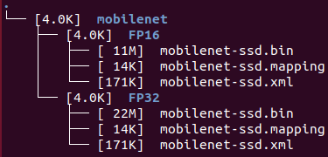
Compression of a Model to FP16 with: “--data_type”
Model Optimizer can convert all floating-point weights to FP16 data type.
The resulting model will occupy about half the disk space and runtime memory.
FP16 is recommended data type for GPU optimizations, and only supported data type for VPU
mo --input_model INPUT_MODEL --data_type FP16
Note: FP16 compression may have some accuracy drop, although for the majority of models accuracy degradation is negligible.
Learn more about FP16 compression:
https://docs.openvino.ai/latest/openvino_docs_MO_DG_FP16_Compression.html

Slide 46
OpenVINO™ Runtime
Notes:
After an optimized IR format model has been generated by MO, the next step is to implement the model into your computer vision application. This is where you will start to use the Inference Engine APIs.

Slide 47
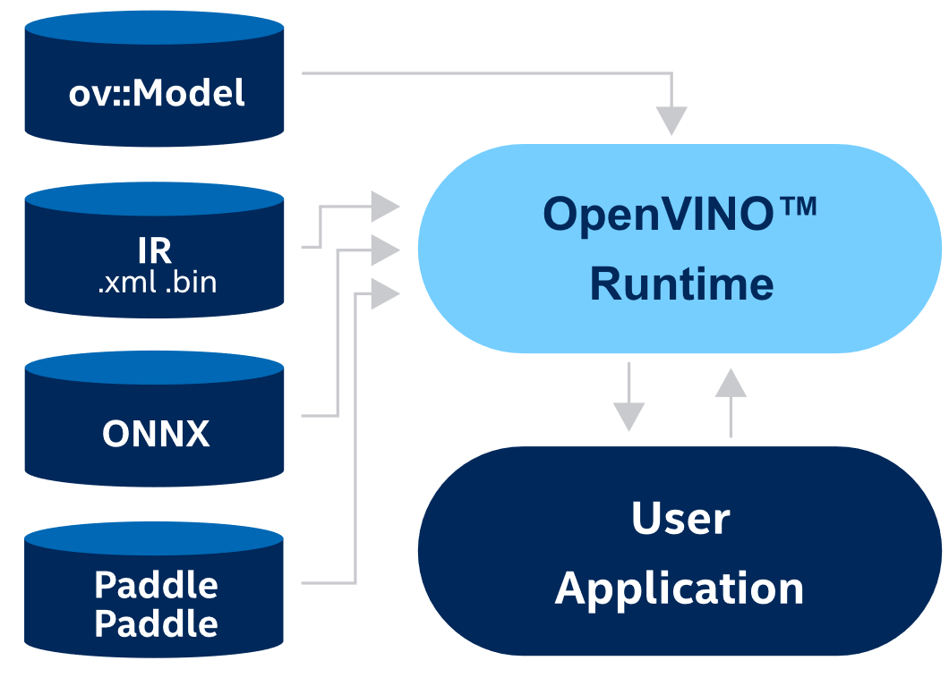
Introducing OpenVINO™ Runtime
OpenVINO™ Runtime is a set of C++ libraries with C and Python bindings providing a common API to deliver inference solutions on the platform of your choice. Use the OpenVINO Runtime API to read an Intermediate Representation (IR), ONNX, or PaddlePaddle model and execute it on preferred devices.
Notes:
Slide4:
After developers have used the Model Optimizer to create an Intermediate Representation (IR), the next step is to use the OpenVINO Runtime to infer the result for a given input data.
Developers will use the OpenVINO Runtime API to read an Intermediate Representation (IR), ONNX, or PaddlePaddle model and execute it on preferred devices
OpenVINO Runtime is a set of C++ libraries with C and Python bindings providing a common API to deliver inference solutions on the platform of developer’s choice: CPU, GPU, or VPU.
The C++ libraries is the primary implementation, C libraries and Python bindings are also available.
OpenVINO Runtime uses a plugin architecture. Its plugins are software components that contain complete implementation for inference on a particular Intel® hardware device: CPU, GPU, VPU, etc.

Slide 48

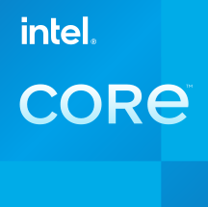

OpenVINO™ Runtime Plugin Architecture
OpenVINO™ Runtime uses a plugin architecture.
Its plugins are software components that contain complete implementation for inference on a particular Intel® hardware device: CPU, GPU, VPU, etc.
Each plugin implements the unified API and provides additional hardware-specific APIs, for configuring devices, or API interoperability between OpenVINO Runtime and underlying plugin backend.
Applications
OpenVINO Runtime (Common API)
CPU plugin
(MKL-DNN , oneDNN)
GPU plugin
(clDNN)
Myriad and HDDL plugins
GNA plugin
Plugin Architecture
Intrinsics
OpenCL™
Movidius™ API
GNA API

Slide 49
Common Workflow for using the OpenVINO™ Runtime API to Implement Inference Pipeline
compiled_model = core.compile_model("model.xml", "AUTO")
infer_request = compiled_model.create_infer_request()
core = ov.Core()
1. Create OpenVINO™ Runtime Core
2. Compile Model
3. Create Inference Request
output = infer_request.get_output_tensor()
output_buffer = output.data
infer_request.start_async()
infer_request.wait()
6. Process Inference Results
5. Start Inference
4. Set Inputs
input_tensor = ov.Tensor(array=memory, shared_memory=True)
infer_request.set_input_tensor(input_tensor)
Inference Loop
Learn more about Inference Pipeline:
https://docs.openvino.ai/latest/openvino_docs_OV_UG_Integrate_OV_with_your_application.html
Notes:
Slide6:
Common workflow for using the Inference Engine API. First, developers need to create create OpenVINO™ Runtime Core to manage available devices and read model objects
Then create a compiled model associated with a single hardware device from the model object. It is possible to create as many compiled models as needed and use them simultaneously up to the limitation of the hardware resources. The ov::CompiledModel allows you to get information inputs or output ports by a tensor name or index, this approach is aligned with the majority of frameworks.
Next, developers will need to create an inference request. ov::InferRequest class provides methods for model inference in OpenVINO™ Runtime
Then Set Inputs
You can use external memory to create ov::Tensor and use the ov::InferRequest::set_input_tensor method to put this tensor on the device
Next Start Inference. OpenVINO™ Runtime supports inference in either synchronous or asynchronous mode. Using the Async API can improve application’s overall frame-rate, because rather than wait for inference to complete, the app can keep working on the host, while the accelerator is busy. You can use ov::InferRequest::start_async to start model inference in the asynchronous mode and call ov::InferRequest::wait to wait for the inference results
Lastly, Go over the output tensors and process the inference results. Different types of model have different output formats, and developers will have their user-defined functions for different use cases. If inferencing multiple images or video stream, then the last three steps will be in a big loop, until the end of the frames.

Slide 50
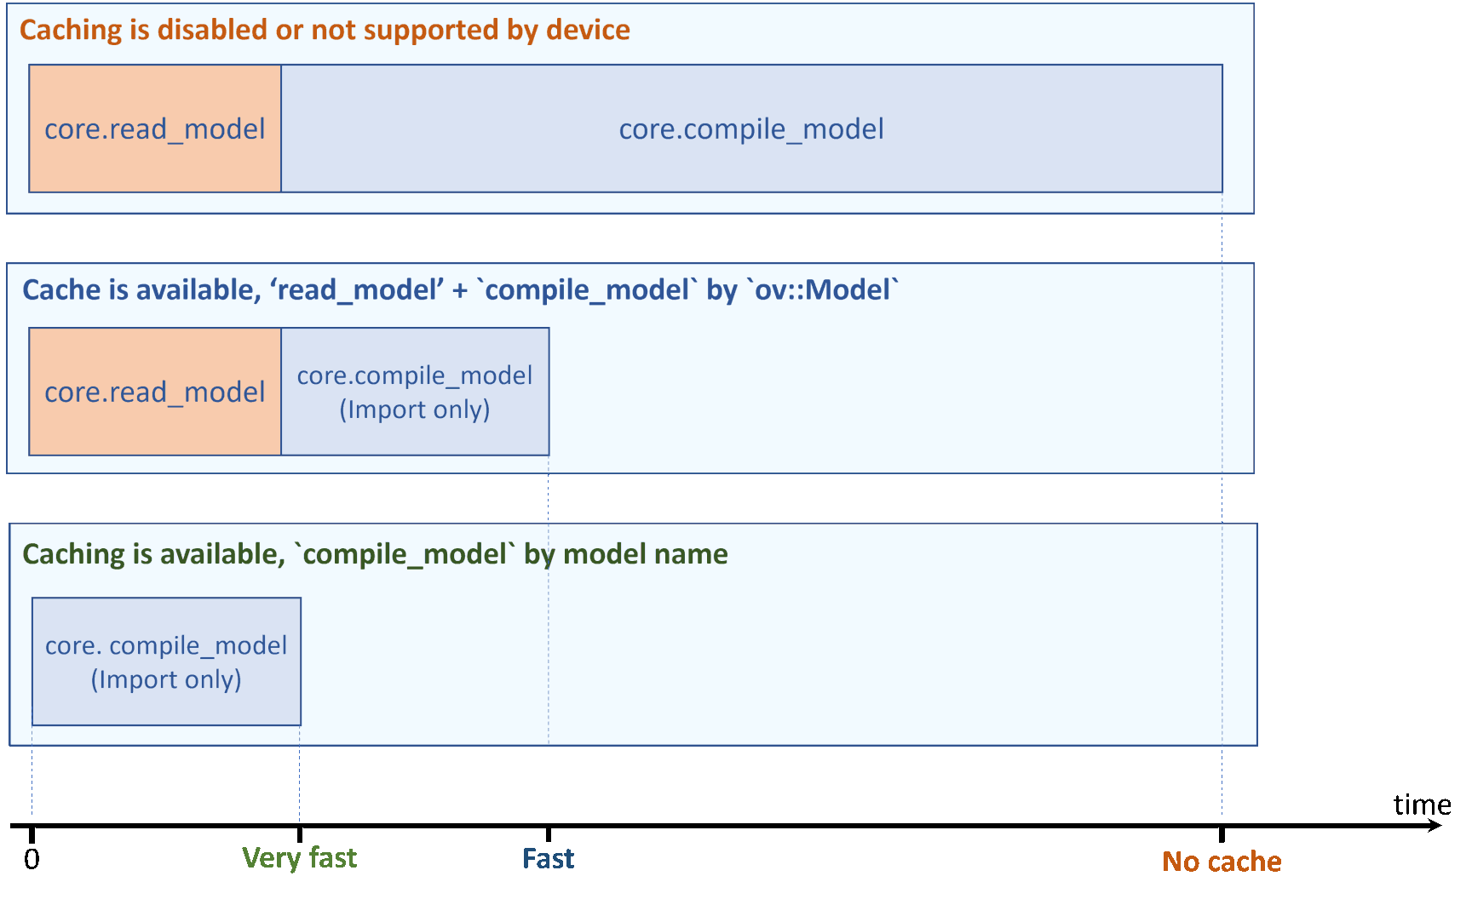
Model Caching
Compile and load network to device can potentially perform several time-consuming device-specific optimizations and network compilations, and such delays can lead to a bad user experience on application startup.
To avoid this, some devices offer import/export network capability, and it is possible to enable model caching to export compiled model automatically.
Reusing cached model can significantly reduce compile model time.
Code Example:
core = Core()
#Set “cache_dir” config option to enable model caching
core.set_property({'CACHE_DIR': '/path/to/cache/dir'})
compiled_model = core.compile_model(model_path=xml_path, device_name=device_name)
Learn more about Model Caching:
https://docs.openvino.ai/latest/openvino_docs_OV_UG_Model_caching_overview.html#doxid-openvino-docs-o-v-u-g-model-caching-overview

Slide 51
Synchronous vs. Asynchronous
The API of the inference requests offers Sync and Async execution
Synchronous - blocks until inference is completed.
Asynchronous – checks the execution status with the wait or specify a completion callback (recommended way).
infer_request.infer()
infer_request.start_async()
Sync API
Transfer 1
Transfer 2
Inference 1
Inference 2
Result 1
Result 2
time
Async API
Result 1
Result 2
Transfer 1
Transfer 2
Inference 1
Inference 2
Notes:
The API of the inference requests offers Sync and Async execution
Each inference request can be executed in two modes, synchronous or asynchronous.
The synchronous execution immediately runs by effectively serializing the execution flow in the current application thread.
This mode is more suitable for the latency-oriented tasks, where the time to a single frame is more important.
The Async “splits” the infer() into start_async() and wait().
“StartAsync” method returns immediately and starts inferencing without blocking main thread, then developers use the “Wait” method to watch on the status of the current inference result. While waiting, the main thread can prepare the image for the next inference request or process the result of previous inference request. In this case, developers will get a better throughput in images per second by dividing the number of images that were processed by the processing time.

Slide 52
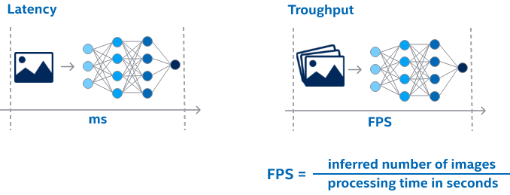
High-level Performance Hints
Each of OpenVINO’s supported devices offers low-level performance settings. Tweaking this detailed configuration requires deep architecture understanding
The idea is to express a target scenario with a single config key and let the device to configure itself in response
The hints are supported by every OpenVINO device and fully compatible with the automatic device selection
Latency measures inference time (ms) required to process a single input.
When it comes to the executing multiple inputs simultaneously then the overall throughput (frames per second, FPS) is usually of more concern
Code Example:
compiled_model = core.compile_model(model, “CPU", {"PERFORMANCE_HINT": “LATENCY"})
Learn more about Performance Hint:
https://docs.openvino.ai/latest/openvino_docs_OV_UG_Performance_Hints.html
Notes:
Slide5:
Generally, performance means how fast the model processes the live data. Two key metrics are used to measure the performance: latency and throughput are fundamentally interconnected.
Latency measures inference time (ms) required to process a single input. When it comes to the executing multiple inputs simultaneously (e.g. via batching) then the overall throughput (inferences per second, or frames per second, FPS, in the specific case of visual processing) is usually of more concern. To calculate throughput, divide number of inputs that were processed by the processing time.
Unlike most accelerators, CPU is perceived as an inherently latency-oriented device. In fact, the OpenVINO toolkit does support the "throughput" mode for the CPU, which allows the Inference Engine to efficiently run multiple inference requests on the CPU simultaneously, greatly improving the overall throughput.
Internally, the execution resources are split/pinned into execution "streams". This feature usually provides much better performance for the networks than increasing batch size.
To specifies the number of CPU execution “streams” for the throughput mode, developers will need to set the key value with the “GetConfig” method of an Inference Engine Core object.
Here the “streams” also means the upper bound for the number of inference requests that can be executed simultaneously. All available CPU cores are evenly distributed between the streams.
The default key value is 1, which implies latency-oriented behavior with all available cores processing requests one by one. For example, if developers try Benchmark App on an 8-core CPU, they will see different performance comparing the default 1 (which is a legacy, latency-oriented scenario) to the setting it to 2, 4, and 8 streams.

Slide 53
Auto-Batching for GPU
The Automatic-Batching performs on-the-fly automatic batching to improve device utilization for applications which have many inference requests.
Batching is a straightforward way of leveraging the GPU compute power and saving on communication overheads.
The automatic batching is implicitly triggered on the GPU when the THROUGHPUT PerformanceMode is specified in the hint.
Code Example:
compiled_model = core.compile_model(model, "GPU", {"PERFORMANCE_HINT": "THROUGHPUT"})
Learn more about Auto-Batching:
https://docs.openvino.ai/latest/openvino_docs_OV_UG_Automatic_Batching.html
Notes:
Slide 6:
The Automatic-Batching is a preview of the new functionality in the OpenVINO™ toolkit.
It performs on-the-fly automatic batching that is grouping inference requests together to improve device utilization, with no programming effort from the user.
The feature primarily targets existing code written for inferencing many requests
For the batch happen transparently and without affecting the application code, inputs gathering and outputs scattering from the individual inference requests is required.
The best way to evaluate the performance of the Automatic Batching is using the benchmark_app, that exists in both C++ and Python versions.
For developers, there are various Performance Considerations to achieve the best performance with the Automatic Batching such as :
Use the requests, grouped by the batch size, together. For example, the first 4 requests are inferred, while the second group of the requests is being populated in the application.
Operate the number of inference requests that represents the multiple of the batch size
Developers can follow the documentation for more such Performance Considerations.

Slide 54
OpenVINO Notebooks - 002-openvino-api
An OpenVINO API tutorial that covers the following:
Load Inference Engine and Show Info
Loading a Model
IR Model
ONNX Model
Getting Information about a Model
Model Inputs
Model Outputs
Doing Inference on a Model
Reshaping and Resizing
Change Image Size
Change Batch Size
https://github.com/openvinotoolkit/openvino_notebooks/tree/main/notebooks/002-openvino-api

Slide 55
OpenVINO Notebooks - 101-tensorflow-to-openvino
https://github.com/openvinotoolkit/openvino_notebooks/blob/main/notebooks/101-tensorflow-to-openvino
This tutorial explains how to convert TensorFlow MobilenetV3 models to OpenVINO IR and then classify an image with OpenVINO's Inference Engine.
OpenVINO Notebooks - 102-pytorch-onnx-to-openvino
https://github.com/openvinotoolkit/openvino_notebooks/tree/main/notebooks/102-pytorch-onnx-to-openvino
This notebook demonstrates how to perform inference on a PyTorch semantic segmentation model using OpenVINO.
OpenVINO Notebooks - 103-paddle-onnx-to-openvino
https://github.com/openvinotoolkit/openvino_notebooks/tree/main/notebooks/103-paddle-onnx-to-openvino
The notebook uses Paddle2ONNX and OpenVINO Model Optimizer to convert a MobileNet V3 PaddleHub model, pretrained on the ImageNet dataset, to OpenVINO IR.
Note: In OpenVINO™ 2022.1, PaddlePaddle models can be loaded and inferenced by OpenVINO Runtime directly
Check out this Notebook: https://github.com/openvinotoolkit/openvino_notebooks/tree/main/notebooks/214-vision-paddle-classification

Slide 56
Dynamic Shapes [New feature in 2022.1]
Static Shape
Conventional “static” model reshaping works well when it can be done once per many model inference calls with the same shape.
Dynamic Shape
The input tensor shape may change on every inference call.
Need a good laugh
Need
a
good
laugh
Add
MVN
Multiply
Add
Reshape
Transpose
What is the weather going to be like today?
What
is
the
weather
going
to
be
like
today?
Add
MVN
Multiply
Add
Reshape
Transpose
What is the term for a task that lends itself to being solved by a computer?
Words, phrases, and sentences come in many lengths, which means every input shape varies from sample to sample.
Dynamic Input Shapes reads and reshapes the model’s network for each input automatically.
This allows sequence processing models, like BERT-based NLP models, to ingest, inference, and output results of varying lengths more efficiently.
What
is
the
term
for
a
task
that
lends
itself
to
being
solved
by
a
computer?
Add
MVN
Multiply
Add
Reshape
Transpose
Code Sample:
import openvino.runtime as ov
from openvino.runtime import Core, Dimension
…
model = ie.read_model(<model_path>)
model_input_layer = model.input(0)
shape = model_input_layer.partial_shape
shape[2] = -1 # To set up bound for the dimension, try shape[2] = ov.Dimension(8,512)
model.reshape({model_input_layer: shape})
compiled_model = ie.compile_model(model=model, device_name="CPU")
Note: In OpenVINO™ 2022.1, Dynamic Input Shapes run on CPUs only.
Learn more about Dynamic Shape:
https://docs.openvino.ai/latest/openvino_docs_OV_UG_DynamicShapes.html
Notes:
What if your task is NLP, where input size varies from sample to sample. The answer is…Dynamic shape. It automatically resizes the network based on given input. You don’t need to do it yourself.

Slide 57
OpenVINO Notebooks - 211-speech-to-text
In this tutorial, we use the quartznet 15x5 model.
QuartzNet performs automatic speech recognition. Its design is based on the Jasper architecture, which is a convolutional model trained with Connectionist Temporal Classification (CTC) loss.
Dynamic Shape is used to reshape the duration dimension of input.
https://github.com/openvinotoolkit/openvino_notebooks/tree/main/notebooks/211-speech-to-text

Slide 58
Auto Device Plugin [New feature in 2022.1]
The AUTO plugin automatically detects processing resources and maximizes inference performance, which is ideal for hybrid architectures and container-based applications that land on unknown devices.
The AUTO plugin uses performance hints to select devices and configure workload logic based on a given target scenario. (Throughput vs. Latency)
Applications
OpenVINO Runtime (Common API)
AUTO plugin
detects processing resources and maximizes inference performance
GNA plugin
CPU plugin
(MKL-DNN , oneDNN)
GPU plugin
(clDNN)
Myriad and HDDL plugins
Plugin Architecture
Intrinsics
OpenCL™
Movidius™ API
GNA API
Code Example:
compiled_model = core.compile_model(model=model, device_name="AUTO", config={"PERFORMANCE_HINT":"THROUGHPUT"})

Slide 59
Auto Device Plugin: Improving First-Inference Latency
The AUTO plugin shifts workloads throughout runtime to maximize performance.
For example, the GPU may be the best device, but GPU initialization takes longer than the CPU because of the time it takes to compile the OpenCL™ kernel.
The AUTO plugin starts inference on the CPU while it loads and compiles for the GPU. When the GPU is ready, the AUTO plugin switches the device to the GPU and releases resources from the CPU.
DEVICE SELECTION
APPLICATION INFERENCE ON AUTO
CPU workloads
COMPILE NETWORK FOR CPU
INFERENCE ON CPU
INFERENCE STOPS ON CPU
COMPILE/LOAD NETWORK FOR GPU
GPU workloads
INFERENCE ON GPU
TIME
116.7
5,800
MS
APPLICATION LOGIC
LOADING NN
INFERENCE

Slide 60
OpenVINO Notebooks - 106-auto-device
A basic introduction to do Auto Device Selection with OpenVINO.
This notebook demostrate how to compile_model with AUTO device, compare the first inference latency (model compilation time + 1st inference time) between GPU device and AUTO device, show the difference performance hints (THROUGHPUT and LATENCY) with significant performance results towards the desired metric.
https://github.com/openvinotoolkit/openvino_notebooks/tree/main/notebooks/106-auto-device

Slide 61
Multi Device Plugin
The Multi-Device plugin automatically assigns inference requests to available computational devices to execute the requests in parallel.
Improved throughput from using multiple devices (compared to single-device execution)
More consistent performance, since the devices share the inference burden (if one device is too busy, another can take more of the load)
Applications
OpenVINO Runtime (Common API)
Multi Device Plugin
(optional but recommended for full system utilization)
CPU plugin
(MKL-DNN , oneDNN)
GPU plugin
(clDNN)
Myriad and HDDL plugins
GNA plugin
Plugin Architecture
Intrinsics
OpenCL™
Movidius™ API
GNA API

Slide 62
Multi Device Plugin
Application
Automatic load-balancing between devices (inference requests level) for full system utilization
Аny combinations of the following devices are supported (CPU, GPU, VPU, HDDL)
As easy as “-d MULTI:CPU,GPU” for cmd-line option of your favorite sample/demo
Device priority
Infer requests
Queue Manager
CPU
GPU
VPU
Convolution
Convolution
Convolution
Add
Add
Add
Clamp
Clamp
Clamp
Group
Convolution
Group
Convolution
Group
Convolution
Add
Add
Add
Code Example:
core = Core()
model = core.read_model(model_path)
compiled_model = core.compile_model(model=model, device_name="MULTI:CPU,GPU")
Clamp
Clamp
Clamp
Convolution
Convolution
Convolution
Add
Add
Add
Convolution
Convolution
Convolution
Add
Add
Add
CPU Plugin
GPU Plugin
VPU Plugin
CPU
GPU
VPU
etc.
Notes:
Another type of plugin which utilize more than one type of available device is called Multi-Device plugin. It automatically assigns inference requests to available computational devices to execute the requests in parallel.
The Benefits of using the Multi-Device plugin are:
One, multiple devices can deliver improved throughput.
Two, more consistent performance can be achieved, since the devices are sharing the inference burden. If one device is too busy, another device can take more of the load.
Using multi-device plugin, the application logic left unchanged, so developers don't need to explicitly load the network to every device and create and balance the inference requests. From the application point of view, this is just another device that handles the actual machinery. The only thing that is required to leverage performance is to provide the names of multiple devices with enough computation power to perform the inferences.
So, just like loading the network to a single device or Hetero plugin, here just change the device name to MULTI, colon mark, and comma-separated device names with no spaces.

Slide 63
Heterogenous Device Plugin
Heterogeneous execution enables executing inference of one model on several devices. Its purpose is to:
Utilize the power of accelerators to process the heaviest parts of the model and to execute unsupported operations on fallback devices, like the CPU.
Utilize all available hardware more efficiently during one inference.
Applications
OpenVINO Runtime (Common API)
Heterogeneous execution enables
automatic inference splitting between several devices
CPU plugin
(MKL-DNN , oneDNN)
GPU plugin
(clDNN)
Myriad and HDDL plugins
GNA plugin
Plugin Architecture
Intrinsics
OpenCL™
Movidius™ API
GNA API

Slide 64
Heterogeneous Device Plugin
You can execute different layers on different Hardware units
Offload unsupported layers on fallback devices:
Default affinity policy
Setting affinity manually
All device combinations are supported (CPU, GPU, MYRIAD, HDDL)
GPU
Convolution
Add
Clamp
GroupConvolution
Add
Clamp
Convolution
Code Example:
compiled_model = core.compile_model(model, device_name="HETERO:GPU,CPU")
CPU
Add
Convolution
Add
Notes:
There’s a special type of plugin offered by Inference Engine offers is called Hetero Plugin, it enables inferencing one network on several devices.
The purpose of this Hetero Plugin is to utilize accelerators power and calculate heaviest parts of network on accelerator and execute not supported layers on fallback devices like CPU, in this way, to get a more efficient hardware usage.
The execution through heterogeneous plugin can be divided to two independent steps, once developers have decided which two or three devices are going to be used to run the inference, the hetero plugin will set the affinity of layers to those devices, then the divided network will be loaded and executed on the corresponding plugin.
The setting of affinity can be done automatically using fallback policy or in manual mode.
The fallback automatic policy follows greedy behavior and assigns all layers which can be executed on single device to execute on that device. Automatic policy does not consider such plugin peculiarities as inability to infer some layers without other special layers placed before or after that layers. If device plugin does not support subgraph topology constructed by Hetero plugin, affinity should be set manually.
The priority of device will be set during network loading step. To use hetero plugin, developers need to put Hetero, colon mark, followed with device names, separated with commas as shown on the screen.
Data needs to be transferred between layers during inference, but adjacent layers now can be executed on different devices. If it takes a relatively long time to transfer data from one part of the network to another in a heterogeneous mode, it makes not much sense to execute them in a heterogeneous mode on these devices.
In this case, developers can manually set the correlation to avoid sending data back and forth multiple times during one inference. To do this, developers will need to query the network first by providing the device priority to get the automatic layer affinity information, then manually update the affinity and set it to the network.

Slide 65
Try Multi Device & Hetero Device Plugins with Benchmark App
benchmark_app –d MULTI:MYRIAD,GPU –m <model> -i <input> -niter 1000
benchmark_app –d HETERO:GPU,CPU –m <model> -i <input> -niter 1000 -pc

Slide 66
Placeholder for Preprocessing API

Slide 67
Multiple Models in One Application Optical Character Detection and Recognition
Notes:
We have already seen the sample application using only one single model, but what if we need to chain multiple models together in one application? Do we need to send the same copy of the original frames to each of the models used in this application? Can we use different devices for inferencing different models? Let’s look at this security barrier demo application and find out the answers from there.

Slide 68
Video Analytics in the OpenVINO™ Toolkit
The Open Model Zoo contains these models and many more
Topology | Type | Description
horizontal-text-detection-0001 | Text Detector | Text detector based on FCOS architecture with MobileNetV2-like as a backbone for indoor/outdoor scenes with more or less horizontal text.
text-recognition-resnet | Text Recognizer | text-recognition-resnet-fc is a simple and preformant scene text recognition model based on ResNet with Fully Connected text recognition head
Notes:
In this demo application, three models will be used. The first model is an object detection model, which can detect multiple classes, the vehicle, and the license plate. The second model can recognize the attributes of a vehicle, such as type and color. The third model is an Optical Character Recognition model trained to read Chinese license plates.

Slide 69
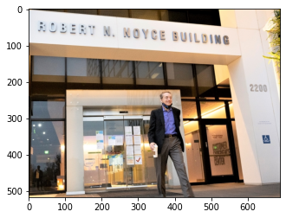
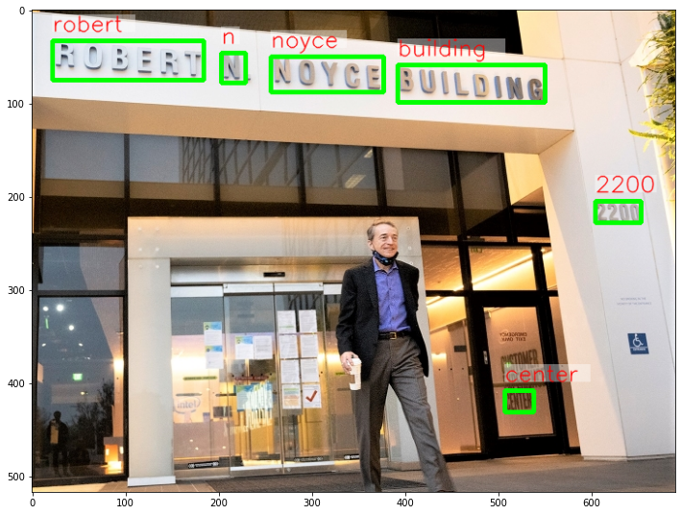
Steps in the Sample Application
Load
Load the OpenVINO™ Library
Download
Download the models from the Open Model Zoo
Convert
Convert the models to Intermediate Representation Format
Load
Load the models and the images
Perform
Perform the horizontal text detection inference
Perform
Perform recognition inference on each region of detected text
Display
Display the results by annotating the image with bounding boxes and labeling with the recognized text.

Slide 70
OpenVINO Notebooks - 208-optical-character-recognition
In addition of horizontal-text-detection-0001 model, text-recognition-resnet is used in this tutorial.
This model reads tight aligned crop with detected text converted to grayscale image and returns tensor that is easily decoded to predicted text. Both model are from Open Model Zoo.
https://github.com/openvinotoolkit/openvino_notebooks/tree/main/notebooks/208-optical-character-recognition

Slide 71
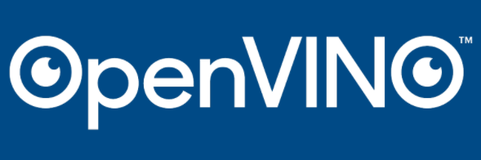
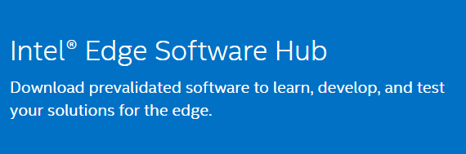

Resources to Get Started
Intel® Distribution of OpenVINO™ Toolkit: https://software.intel.com/content/www/us/en/develop/tools/openvino-toolkit.html
Intel® Edge Software Hub: https://software.intel.com/content/www/us/en/develop/topics/iot/edge-solutions.html
Intel® DevCloud for the Edge:
https://devcloud.intel.com/edge/home
To get access to the full video series, please complete the short form: http://intel.ly/38B9ix6

